Slide 1
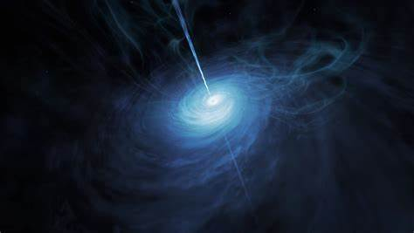
STELLAR CLASSIFICATION
Unlocking the secrets to classifying interstellar objects
Thomas Lanphier
Tom Lento
Edward Goldhill
John Molenda

Slide 2
EXPLAINING OUR DATA
Plus a little bit of background…

Slide 3
Sloan Digital Sky Survey
Found on Kaggle
100,000 stellar objects surveyed
Classified as either a star, galaxy, or quasar*
Measurements included:
Unique object identifiers
Alpha & Delta declination angle (indicates where the object is located relative to the Earth)
Light filters used based on the type of light the object emits
Redshift - the radiation that travels through expanding space, and that though to Hubble's law, the distance and relative velocity to Earth can be determined.
Why this data?
We all love astronomy! 👽
Dataset was clean with only one little speck of an outlier
Our mission → create accurate machine learning models that can be used on future data to determine whether the objects are stars, galaxies, or quasars
*Quasars are a type of galaxy formed in the early stages of our universe with a supermassive blackhole at its center. The black hole is ejecting matter thousands of lightyears into space and is so bright that it can easily outshine the luminosity of all the stars in a galaxy

Slide 4
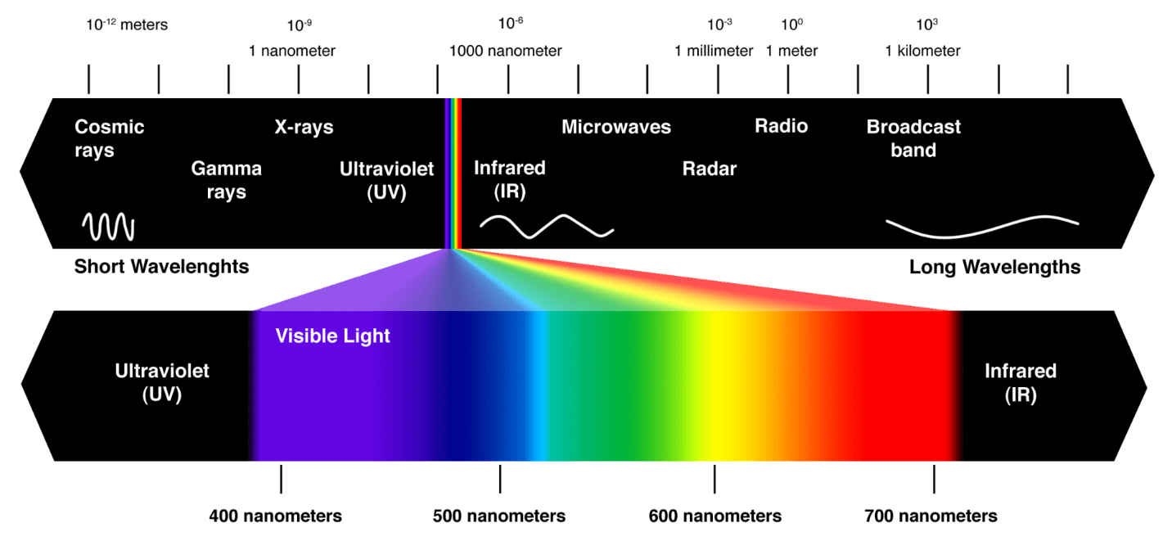
Stellar Filters & the Electromagnetic Spectrum
u = Ultraviolet filter in the photometric system
g = Green filter in the photometric system
r = Red filter in the photometric system
i = Near Infrared filter in the photometric system
z = Infrared filter in the photometric system

Slide 5
Analyzing our Data

Slide 6
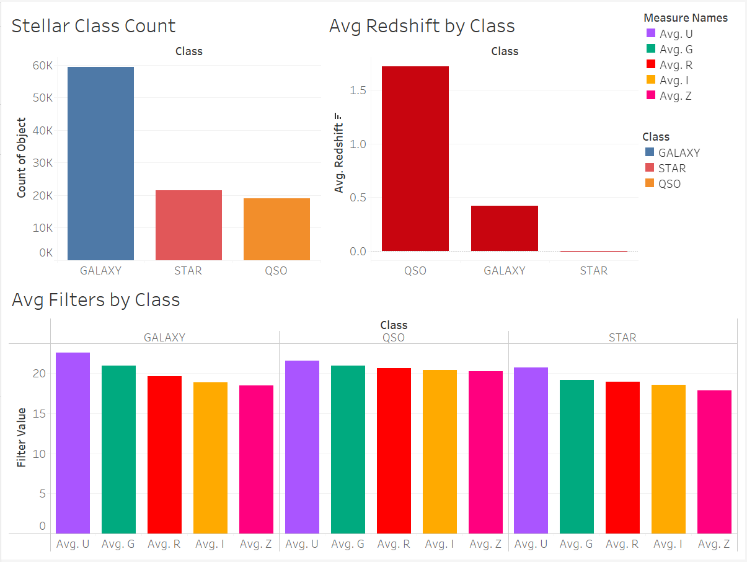

Slide 7
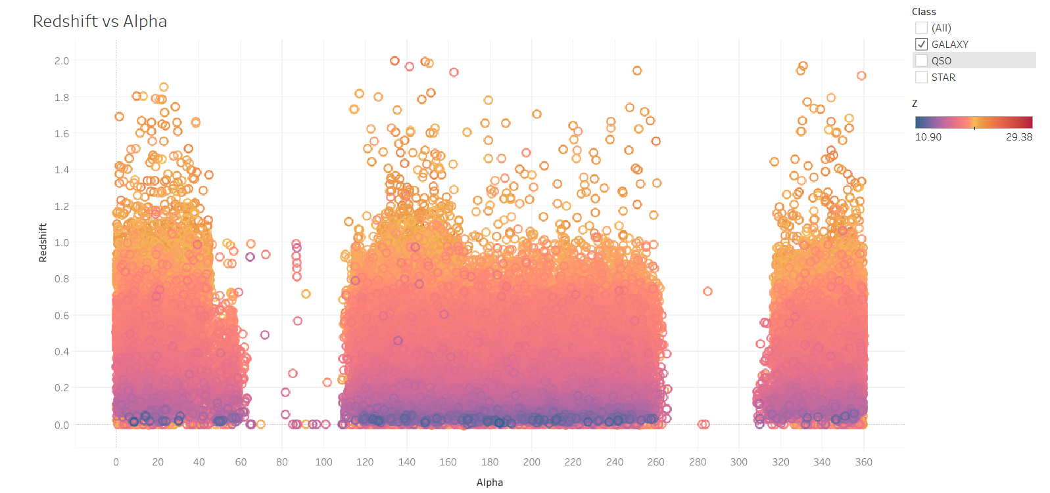
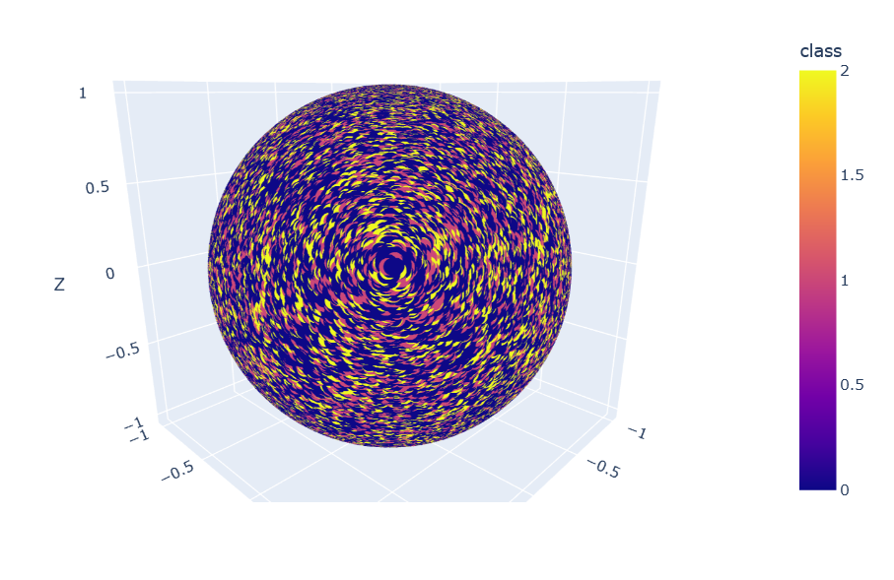

Slide 8
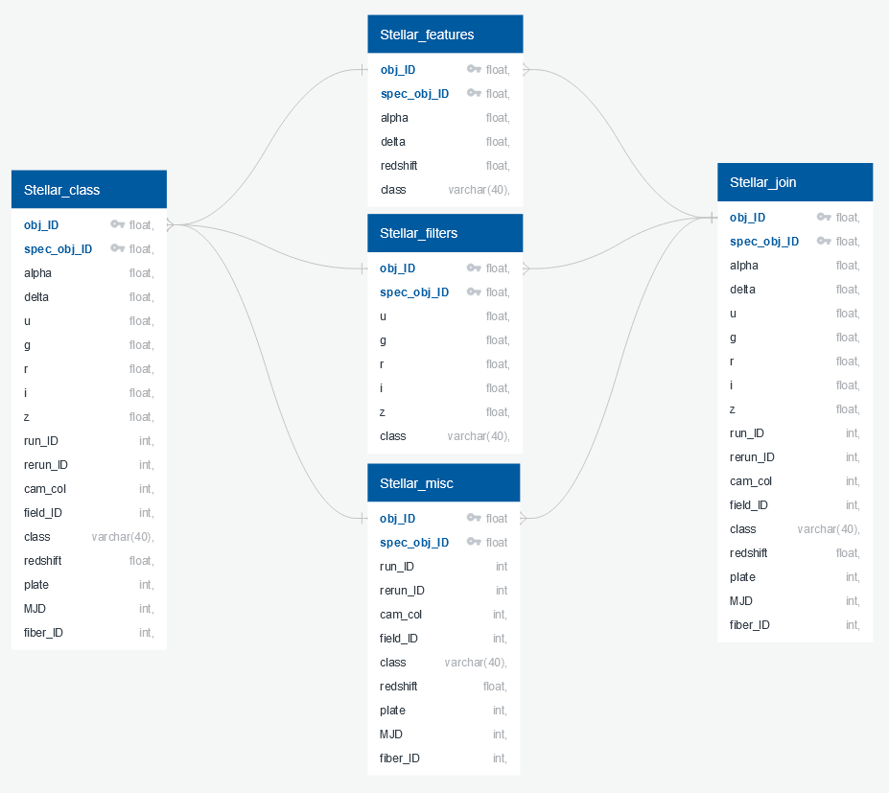

Slide 9
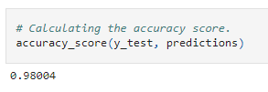
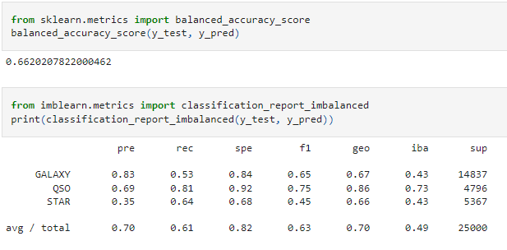
Classification Models
Random Forest Classification: 98.0%
K-Means: 70.4%
Neural Network (w/o redshift): 87.6%
Undersampling
66.2% accuracy, but the model is very poor at predicting stars - meanwhile it is highly accurate at predicting galaxies

Slide 10
Technologies, Languages, Tools, and Algorithms
Pandas
SKLearn
TensorFlow
SQLAlchemy
Python
SQL
Jupyter
Postgres
Tableau
Random Forest
K-Means
Neural Network

